Slide 1


FLORIQUE World Of Flower Stores
Discover the Beauty of Fresh Flowers
Jode Shibli
Osama Ghaliah
Naseem Atrash
Hamad Tarabeih

Slide 2
System Description & Need
Objective:
Enhancing flowers shopping experience.
Description:
Florique is a cutting-edge flower stores application designed to revolutionize the way customers browse, customize, and purchase floral arrangements, while providing shop owners with powerful tools for inventory management, order processing, and customer engagement.
Why would Florique be needed:
Bridging the digital gap in the traditional flower market.
Meeting modern consumer expectations for convenience and customization.
Providing shop owners with tools to optimize operations and grow their business.

Slide 3
Florique’s Features
Feature 1
Feature 2
Feature 3
Feature 4
Quickly browse and filter stores
Tracking orders and updating their status
Inventory management and revenue analytics
Placing orders
using a special bouquet designer

Slide 4
Roles
Jode
Osama
Naseem
Hamad
Customer’s Backend
Shop Owner’s Backend
Customer’s
Front-End
Shop Owner’s Front-End
Custom
Bouquet Design

Slide 5
Requirements
 | functional | non-functional
1 | Registration & login | Convenient, fast and flexible usage
2 | Rating completed orders & expressing feedback | Continuous Service
3 | Updating working days | -
4 | Posting a job ad | -

Slide 6
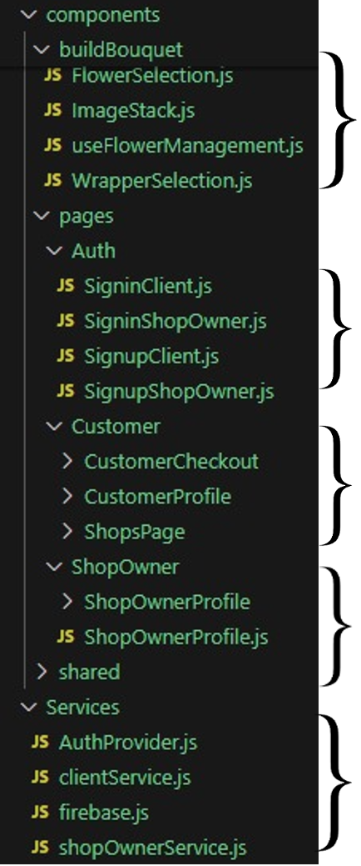
Project’s Division
Custom Bouquet Designer
Authentication
Customer Side
Store Owner Side
Backend

Slide 7
Unfinished Tasks
01
02
03
Job ads still pop up even if there is none.
Real transactions and their encoding
Once finishing to design a bouquet, the bouquet must be added as an item to the cart instead of immediately placing an order.

Slide 8
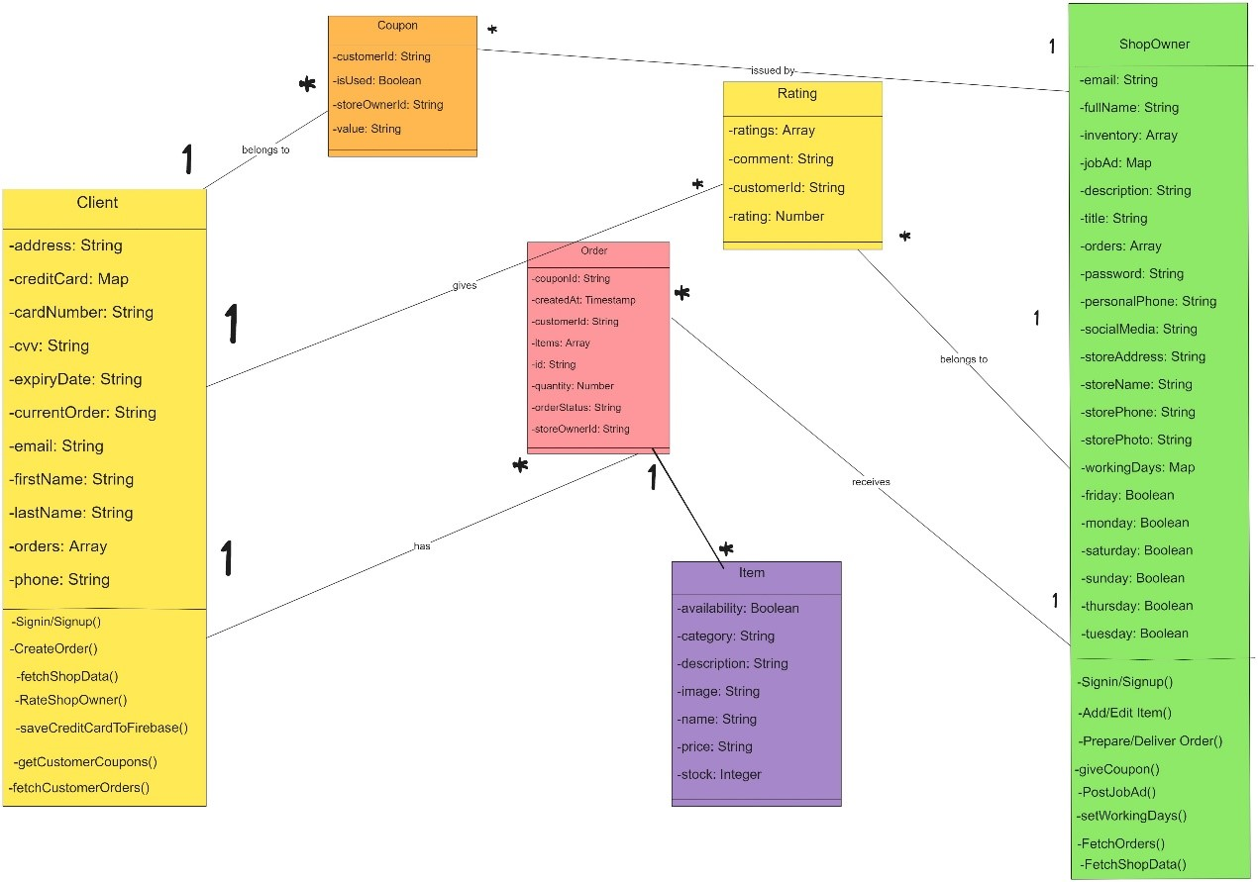
Class Diagram

Slide 9
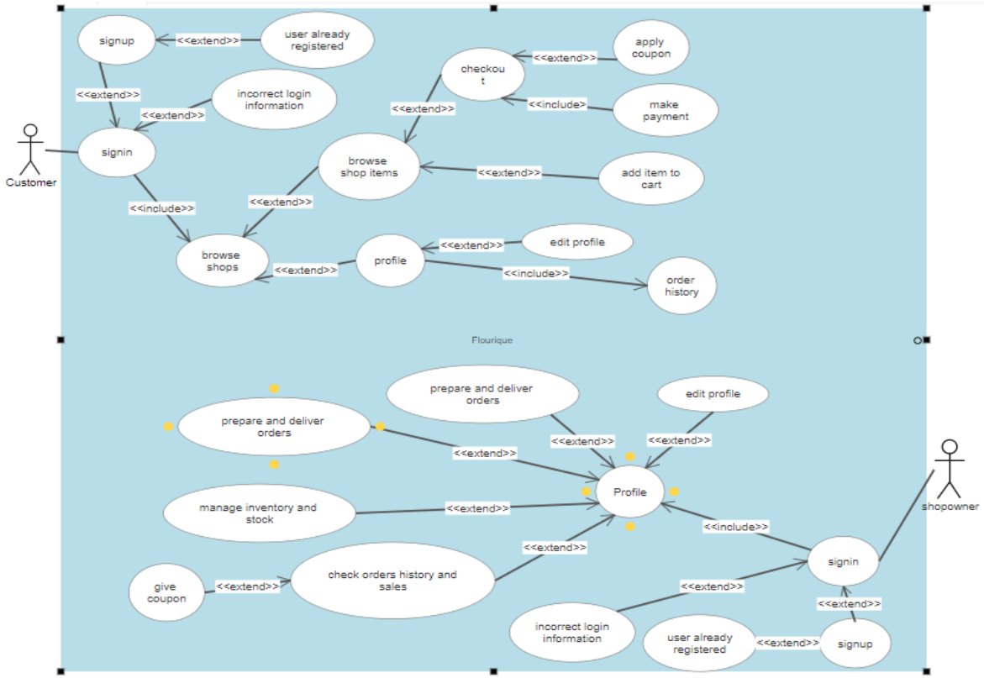
Use-Case
Diagram

Slide 10
Challenges We Faced
In Bouquet Designer
In Back-End
In Front-End
Adapting Figma with orders realism.
Fetching orders for both owners and customers.
Getting familiar with M.U.I. library.

Slide 11


Sneak Peek
https://www.youtube.com/watch?v=NfDBL16OOYQ

Slide 12



Thank You!
Any questions?

